Slide 1
Blood bank management system
Presented by :
Hemendra Chandaluri
Junior Software Engineer
DE Team

Slide 2
Objective:
Build a Data Warehouse for Blood Bank Management System.
Enable analytics and reporting on donations, donors, blood tests, and recipients.
Key Business Goals:
Track blood donations over time
Monitor donor activity
Understand geographic distribution of donors
Track blood testing outcomes
Support hospital demand for blood
Outcome
A structured analytics layer supporting business reports.

Slide 3
Monthly donation trends by blood type
Donor demographics
Donor retention risk
Hospital demand vs supply
Urgent requests analysis
Seasonal donation patterns
Daily operations summary
Per day inventory levels by blood group
Geographic distribution of donors
Required Business Reports:

Slide 4
Source Dataset Overview
Dataset domains | Tables | Key information
Donor Management | donors donor_history | Donor personal details Blood group Donation history
Blood Donation Transactions | donations | Donor who donated Hospital where donation occurred Donation date
Blood Testing Operations | blood_tests technicians tasks technician_tasks | Disease tests performed Test results Technician assignments
Blood Inventory & Compatibility | blood_inventory blood_type_compatibility | Blood units available Compatibility between blood groups
Hospital & Blood Recipients | hospitals recipients | Hospital details Blood request information Recipient urgency levels

Slide 5
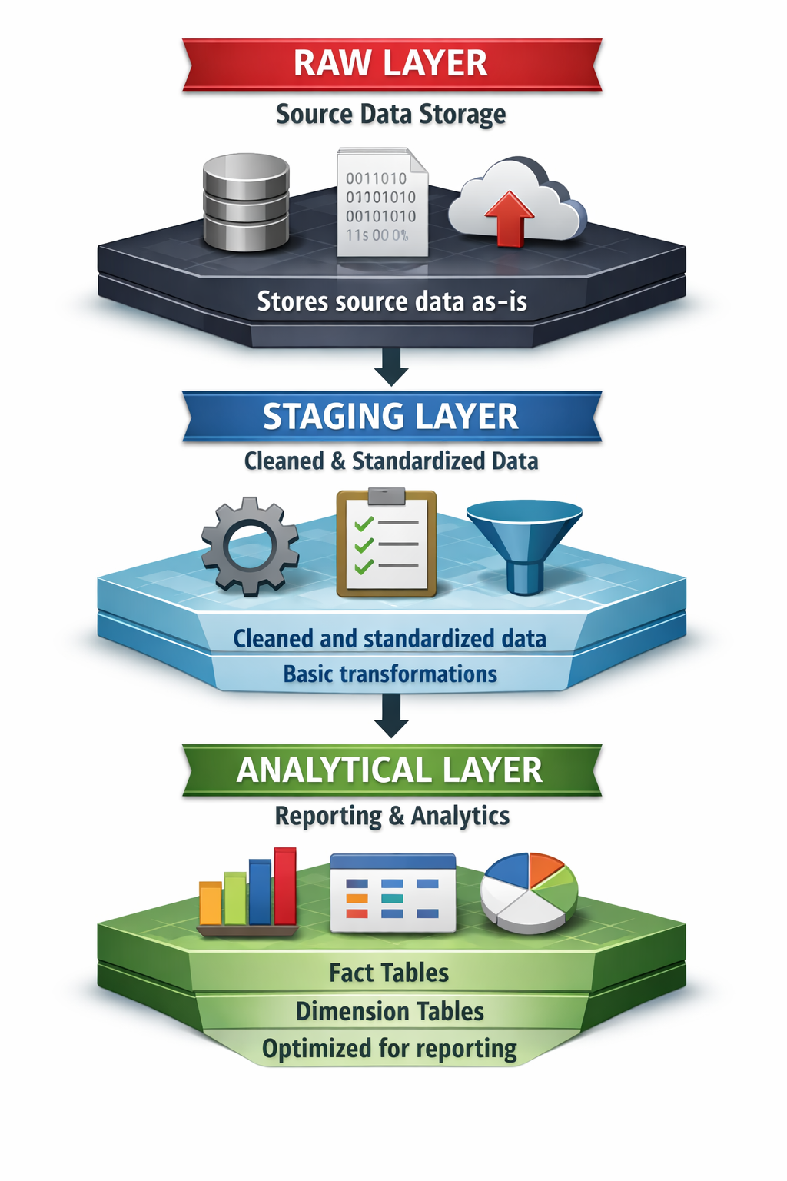
Data Warehouse Architecture

Slide 6
RAW Layer (Truncate & load)
Raw Layer Characteristics
Data ingested from source system
Stored without transformations
Stores latest data
Acts as single source of truth
Example tables:
raw_donors
raw_donations
raw_recipients
raw_blood_tests

Slide 7
Staging Layer
Purpose of Staging Layer
Data cleaning
Standardizing column names
Type conversions
Removing inconsistencies
Example tables:
stg_donors
stg_donations
stg_recipients
stg_blood_tests

Slide 8
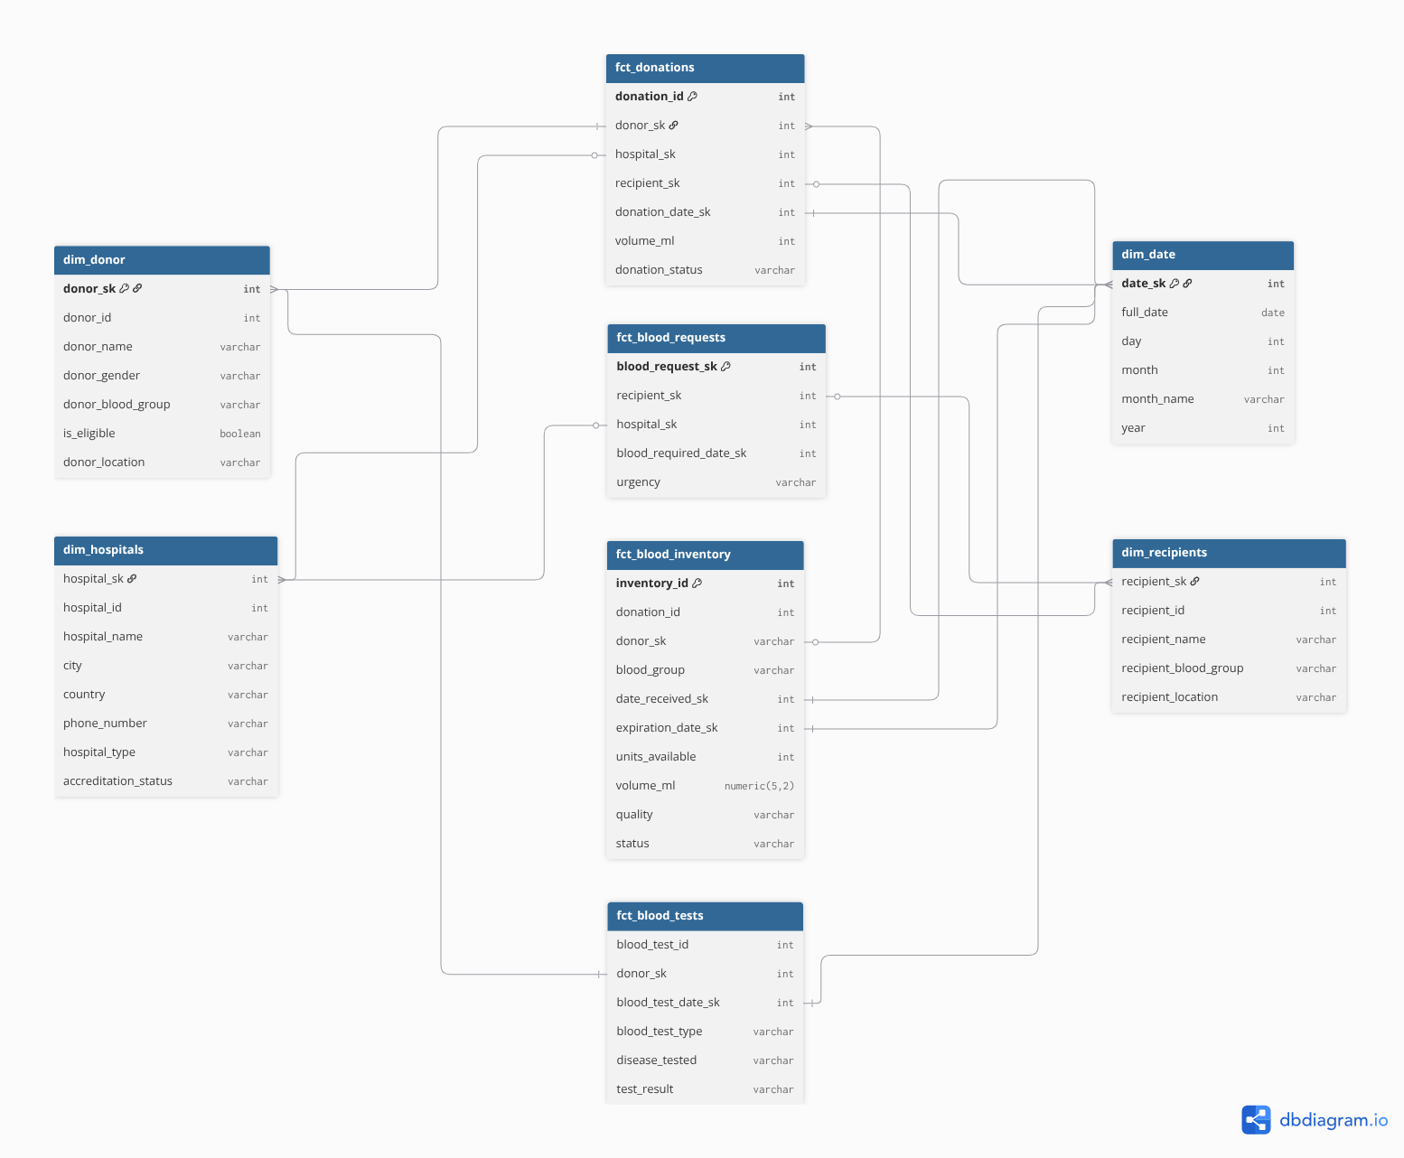
Data Model ER Diagram
(Fact + Dimension)

Slide 9
Analytical layer

Slide 10
DIMENSION Tables
Dimension tables store descriptive attributes that provide context to fact data.
They allow analysts to filter, group, and categorize facts.
Dimension tables typically contain :
Descriptive attributes (name, category, location, etc.)
Primary key used to join with fact tables
Slowly changing attributes (e.g., address changes)
In this data warehouse, Dimension tables store descriptive attributes that provide context to the events recorded in fact tables.

Slide 11
dimensions Implemented
dim_donor
dim_recipients
dim_hospitals
dim_date
DIMENSION DESIGN STRATEGY
The warehouse uses Slowly Changing Dimensions (SCD Type 2).
This approach allows the system to track historical changes in dimension attributes.

Slide 12
Fact Tables
Fact tables capture measurable business events occurring in the system. They store transactional data and connect to dimension tables through foreign keys.
Fact tables typically contain :
Numeric measures (counts, quantities)
Foreign keys referencing dimensions
Event-level data
In this data warehouse, fact tables are designed using a transaction fact model, where each record represents a single event.

Slide 13
Fact Tables Implemented
fct_donations
fct_blood_requests
fct_blood_inventory
fct_blood_tests
FACT TABLE CHARACTERSTICS
Event-based transaction facts
Connected to multiple dimension tables
Designed to support analytical queries
Built using incremental loading strategy in DBT

Slide 14
DATA MODELLING APPROACH

Slide 15
DIMENSION MODELLING STRATEGY
The data warehouse follows a Star Schema design.
CHARACTERSTICS :
Fact tables at the center
Dimension tables surrounding facts
Simplified query structure
Optimized for analytical queries
BENEFITS :
Faster aggregations
Easy reporting
Simplified data exploration

Slide 16
Surrogate keys
Surrogate keys were generated for dimension tables.
PURPOSE :
Avoid dependency on source system keys
Maintain historical records
Support Slowly Changing Dimensions
Surrogate keys were generated using DBT utilities.
EXAMPLE :
generate_surrogate_key(['donor_id','dbt_valid_from'])

Slide 17
DATA TRANSFORMATION USING DBT

Slide 18
TRANSFORMATION FRAMEWORK
DBT (Data Build Tool) was used to manage transformations in the warehouse.
KEY RESPONSIBILITIES OF DBT :
SQL-based transformations
Model dependency management
Incremental data loading
Data testing and validation
INCREMENTAL PROCESSING STRATEGY
To optimize performance, tables were built using incremental materialization.
Strategy used : delete + insert
This approach:
Deletes existing records matching the unique key
Inserts updated records from the source
Benefits:
Avoids full table rebuilds
Efficient updates & Maintains consistency with source data

Slide 19
Report Implementation

Slide 20
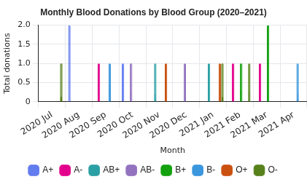
Report
Monthly Donation Trends by Blood Type
WHAT THIS REPORT SHOWS
This report analyzes the number of blood donations per month categorized by blood group.
It helps identify seasonal donation patterns and availability of different blood types over time.
The analysis aggregates donation events by year, month, and donor blood group to understand donation trends.
FACTS AND DIMENSIONS USED
fct_donations
dim_donor
dim_date

Slide 21
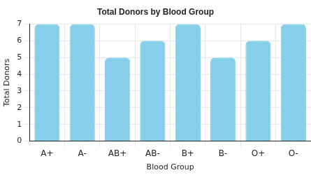
Report
Donor Distribution by Blood Group
WHAT THIS REPORT SHOWS
This report analyzes the number of registered donors for each blood group in the system. It helps understand the availability of donors across different blood types.
The analysis considers only the current active records from the donor dimension to avoid counting historical versions created by SCD Type 2.
FACTS AND DIMENSIONS USED
dim_donor

Slide 22
Report
Donors at Risk of Becoming Inactive
WHAT THIS REPORT SHOWS
This report identifies eligible donors who have not donated in the last 180 days (6 months).
Even though these donors are still marked as eligible, the absence of recent donations may indicate a risk of donor inactivity.
The report lists such donors and calculates the total number of donors at risk.
FACTS AND DIMENSIONS USED
dim_donor
fct_donations
dim_date

Slide 23
Report
Hospital Demand vs Supply (Blood Inventory Availability)
WHAT THIS REPORT SHOWS
This report analyzes the availability of blood inventory on dates when hospitals have requested blood.
It calculates the number of blood units and total blood volume available for each blood group on the requested dates, considering only usable inventory.
The analysis also accounts for inventory validity periods, ensuring blood units are counted only between their received date and expiration date.
FACTS AND DIMENSIONS USED
fct_blood_inventory
fct_blood_requests
dim_date

Slide 24
Report
Urgent Blood Requests Analysis
WHAT THIS REPORT SHOWS
This report analyzes how many blood requests are marked as high urgency and calculates the percentage of urgent requests for each blood group.
It helps understand which blood groups are most frequently required in urgent situations and how emergency demand varies across blood types.
FACTS AND DIMENSIONS USED
fct_blood_requests
dim_recipient

Slide 25
Thank you!

